Slide 1

Scaling Trust: AI-Powered Detection of Online Harms
This presentation outlines our AI solution. It detects online harms to enhance digital trust. We address misinformation, fake links, and deepfakes. Our goal is to protect users and businesses.

Slide 2
Opportunities for AI-Powered Harm Detection
Differentiation
Problem Solving
Unique Selling Point
Our solution uses advanced AI. It adapts to evolving online threats. It is more effective than existing methods.
We accurately identify and flag harmful content. This reduces fraud and protects user privacy. It builds online trust.
Real-time detection prevents harm before it spreads. Our user-friendly interface simplifies reporting.

Slide 3
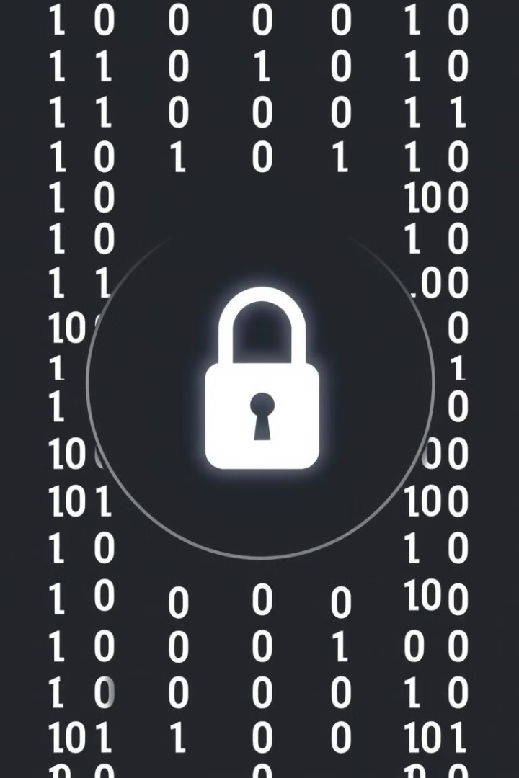
Key Features of Our AI Solution
1
Fake Link Detection
2
Harmful Website Blocking
Identifies malicious URLs. Prevents phishing attacks in real time.
Blocks access to dangerous sites. Protects users from malware.
3
Deepfake Detection
Analyzes videos and images. Flags manipulated content quickly.

Slide 4
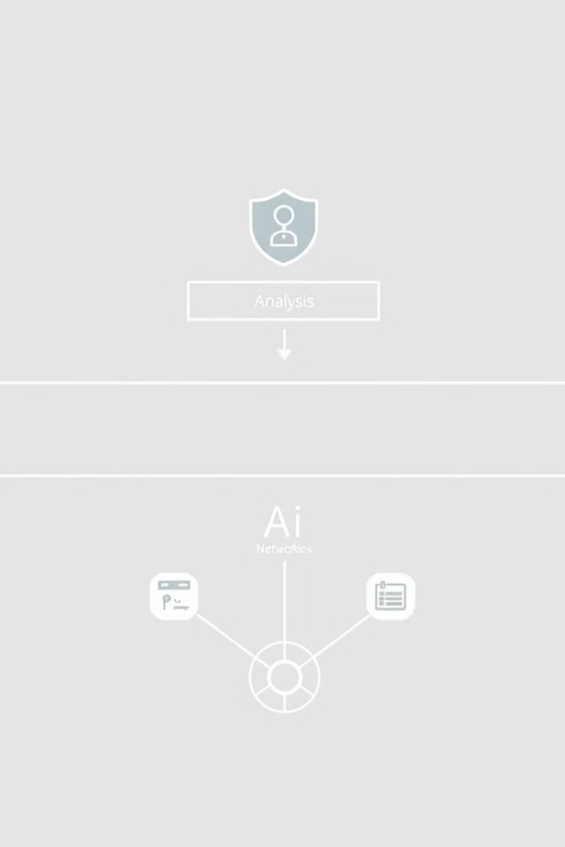




Use-Case Diagram: AI Detection Process
User Input
User encounters a suspicious link or website.
AI Analysis
AI algorithms analyze URL and content.
Threat Assessment
System determines the risk level.
Action Taken
Harmful content is blocked or flagged.

Slide 5
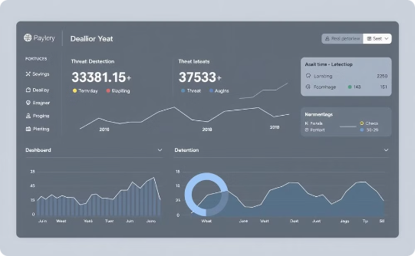
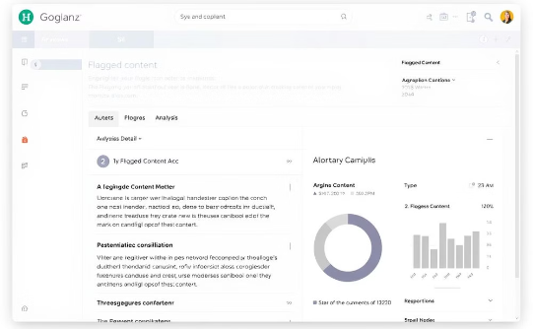
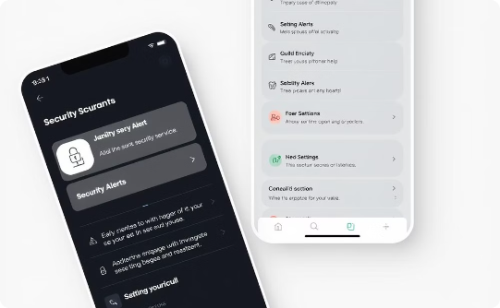
Mockups of Our Proposed Solution
Real-Time Dashboard
Content Analysis
Mobile Alerts
Monitor threats in real time.
View detailed analysis of flagged content.
Receive instant security alerts on your device.

Slide 6
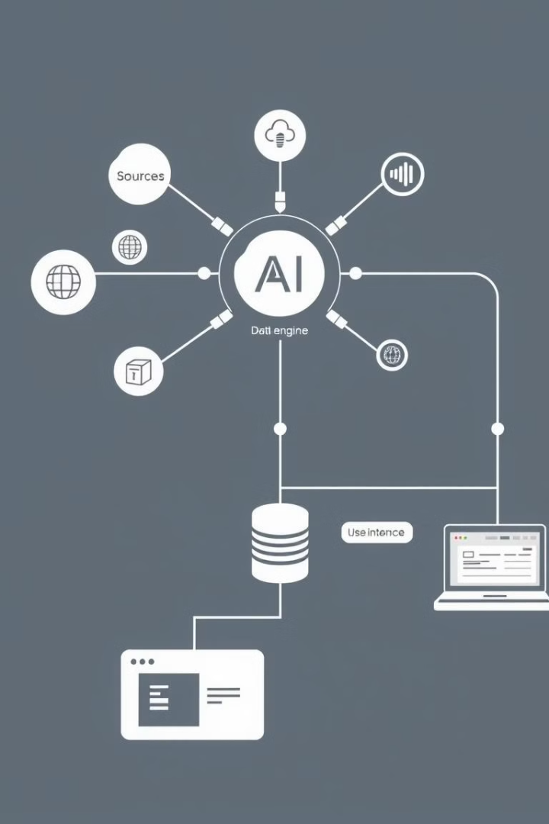
Architecture Diagram of Our Solution
1
Data Input
Data sources include websites and user reports.
2
AI Engine
Our AI algorithms analyze incoming data.
3
Database
Threat intelligence database is updated constantly.
4
User Interface
Users access data through a web or mobile app.

Slide 7




Technologies Used in Our Solution
Python
TensorFlow
Cloud Services
Primary language for AI development.
Framework for machine learning models.
Scalable infrastructure for processing data.
We are building our project on IDX. We are integrating Gemini APIs for advanced AI capabilities.

Slide 8

Estimated Implementation Costs
$50K
$10K
$20K
Initial Setup
Monthly Maintenance
Scaling Costs
Covers infrastructure and initial AI model training.
Includes updates and ongoing support.
Additional resources for increased data processing.

Slide 9
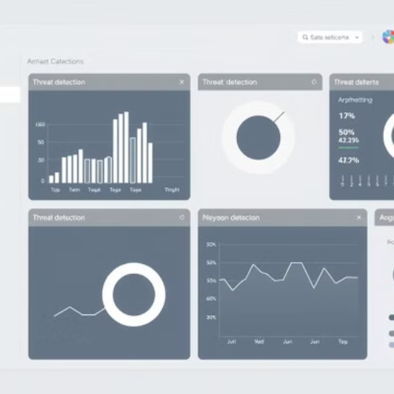
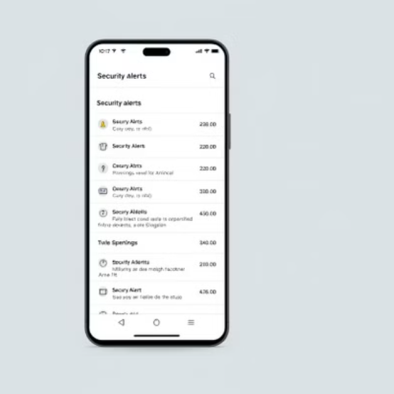

Snapshots of the MVP
The MVP showcases core detection capabilities. It provides a user-friendly interface. It includes real-time monitoring.

Slide 10

Future Development and Additional Details
Enhanced AI
Community Reporting
Improve detection using machine learning.
Allow users to report suspicious activity.
API Integration
Integrate with other security platforms.

Slide 11


